Slide 1

UNICORN-INMOBI
GROUP NUMBER-9

Slide 2
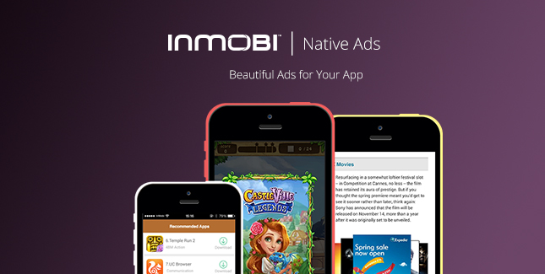
PRESENTED BY-
1.Prathamesh Ugale (Group Leader)
2.Shakti Prasad
3.Amit Modi
4.Mudit Kumar
5.Yashvi Jain
6.Kshitij Chaudhari

Slide 3

History
Formerly – mKhoj
Founded – 2007
Founder – 1.Naveen Tewari
2.Mohit Saxena
3.Amit Gupta
4.Abhay Singhal
Industry – Internet
Founders of Inmobi (source-glassdoor)

Slide 4
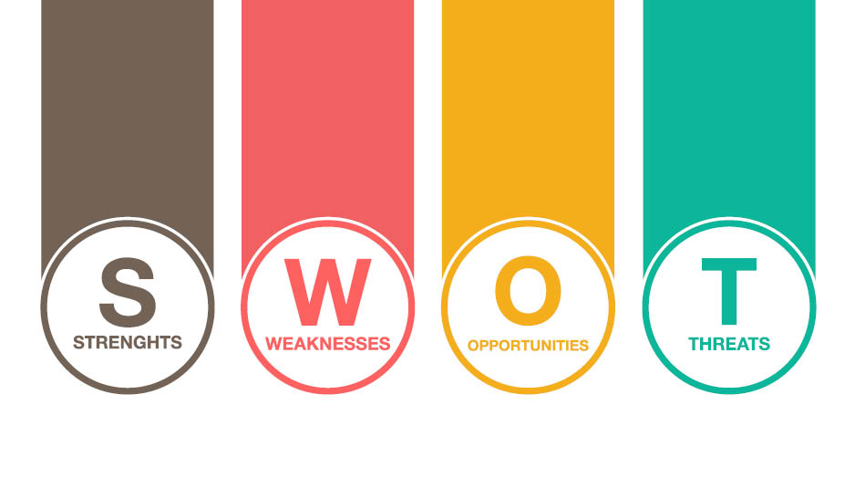
SWOT Analysis

Slide 5
Strength-
The wide product portfolio can allow the organisation to expand the customer base and offset the losses from one product category with benefits obtained from the other.
The wide product portfolio can allow the organisation to expand the customer base and offset the losses from one product category with benefits obtained from the other.
The wide product portfolio can allow the organisation to expand the customer base and offset the losses from one product category with benefits obtained from the other.
Workplace diversity can also act as a major business strength, particularly when the organization intends to operate in the international market.

Slide 6
Weakness-
1. Insufficient budget for the marketing and promotion activities weakens the firms’ ability to expand the customer base and encourage repeat purchase.
2. The inability to understand customers’ needs and expectations lead to an ineffective strategic decision-making process. With this weakness, the organisation may not be able to identify the potential improvement seeking areas in product/service mix.
3. The prices charged by the business may not be perceived as justified when compared to the product/service characteristics. It indicates the need to revise the pricing strategy.
4. The organisation can draw the criticism from the environmentalists for its poor waste management practices and inability to integrate sustainability in business operations.

Slide 7
Opportunities
1. The exponential growth in the population, and particularly in the existing or potential customer segments is a great growth opportunity for the business organization.
2. The changing customer needs, tastes and preferences can act as an opportunity if the business organization has good market knowledge.
3. The emergence of e-commerce and social media marketing as a trend can be a great opportunity for InMobi Reimagining Mobile Advertising if it can ensure strong online presence on different social networking sites.
4. The subsidies provided by the government and other policies to make the business environment more friendly is a positive external environmental factor for InMobi Reimagining Mobile Advertising.

Slide 8
Threats
1. The changing regulatory framework and introduction of new stricter regulations impose a major threat to the InMobi Reimagining Mobile Advertising. It makes compliance with legal standards more complex and challenging for the business organization. Inability to comply with changed regulations raises the risk of expensive law suits.
2. The increasing number of direct and/or indirect competitors affects the organization's ability to sustain and expand the customer base.
3. The rise in inflation increases the cost of production and affects the business profitability.
4. The growing environmental sustainability trends act as a major threat when offered products/services are not environment friendly. It draws the negative publicity and criticism from the environmentalists and affects the brand image in a competitive market.

Slide 9

Business Model Canvas

Slide 10

Value Prepositions-
1. To Engage consumers through mobile advertising.
2. To discover new products and services by providing contextual and personalized ad experiences on mobile devices.
3. To enable consumers and businesses to make smarter decisions.
4. The platform analyses trends in consumer usage of the app.
5. Enabling it to customize recommendations for retailers’ products and services.
old logo

Slide 11

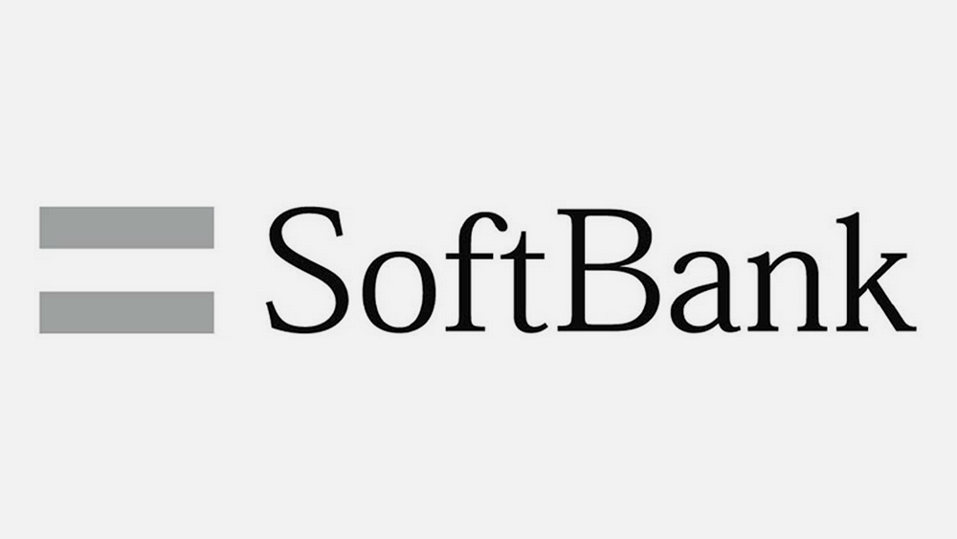
Key Partners-
1. Partnership with more than 30000 apps and websites(publishers).
2. It acquired AerServ a programmatic and network company.
3. Other acquisitions include Metaflow Solutions and Overlay Media.
4. Softbank Capital and Kleiner Perkins Caufield as an investors.
5. Independent mobile attribution platforms(TUNE, kochava, Appsflayer, TalkingData, Apsalar, Adjust and AdMaster).
6. The company has strategic partnership with TalkingData.

Slide 12
Key Resources
1. Mobile Advertising platform.
2. Information such as location and app interests to deliver ads that align with a user’s interest.
3. Footprint extension extended to 700 million smartphone owners worldwide.
4. Cloud-based architectures to simplify advertising.
5. Software features(gaming, social, news, entertainment, sentiment analysis, big-data, user behaviour).
6. Funding
7. Engineering.
8. Sales/Marketing.
9. Customer Service.

Slide 13
Customer Segments-
1. Retailers- The company enables retailers to creatively promote their stores in apps so that consumers can discover.
2. Brands- The company enables brands to understand consumer perceptions of their message by using Miip’s sentiment analysis feature.
3. Developers- The company enables developers to embed Miip in their apps so they can promote can promote and monetize them.

Slide 14
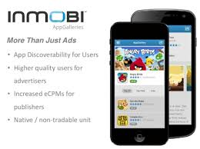
Channels-
1. Website
2. Free Phone consultations
3. Events such as conferences
4. Videos
5. White Papers
6. Webinars
7. Presentations
8. Social Media

Slide 15

Customer Relationship
1. Brand
2. Design
3. Less intrusive product and more user-friendly
4. Customization
5. Self-service
6. Automation
7. Real-time data
8. Contextual
9. Relevant and curated recommedetions

Slide 16

Revenue Streams
1. Platform fees
2. Advertising fees
3. CPC
4. Enterprise product sales
5. It takes money from advertising ( who want to reach certain kind of users)

Slide 17
Key Activities
1. Platform development and maintenance
2. Management
3. Advertising
4. Media buying
5. Report Writing
6. Sales
7. Technology
8. Business Development
9. Teamwork
10. Digital Media

Slide 18

Cost Structure
1. It pays a fraction of it to publishers (website/apps) to show the advertiser ads to the end users
2. Research and development
3. Heavy investment in technology
4. Marketing and sales
5. Help support
6. IT operations
7. Partnerships and Agreements

Slide 19
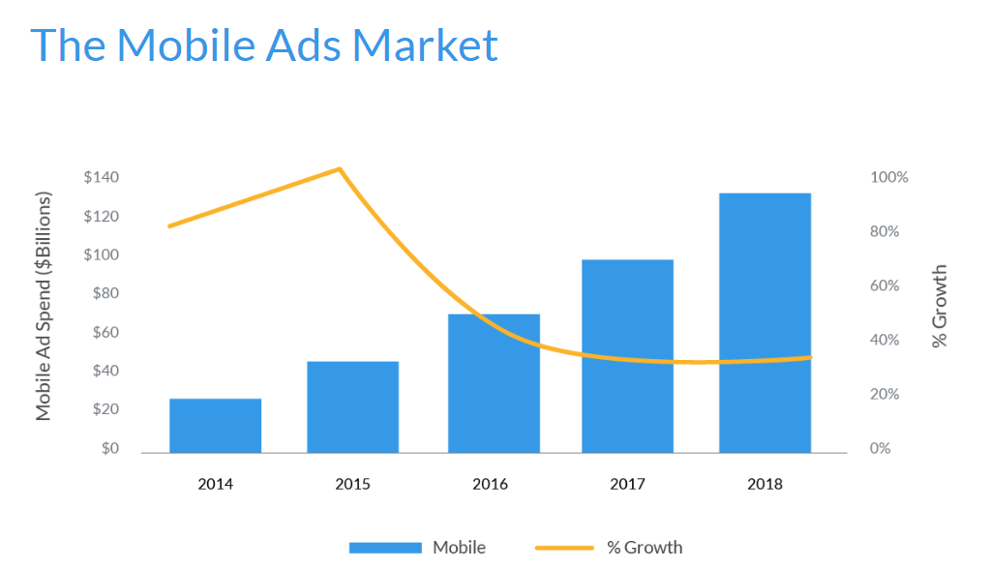
The Mobile Ads Market
Source-media.com

Slide 20
Characteristics of Inmobi
1. Largest independent mobile ad network
2. 1 Billion monthly unique ad impresssions
3. Live in 165+ countries

